Slide 1
Email Spam Classifier Project
Prepared by-
Purva Sonsare

Slide 2
Agenda
INTRODUCTION
ANALYTICAL PROBLEM FRAMING
MODEL/S DEVELOPMENT AND EVALUATION
CONCLUSION
LIMITATIONS OF THIS WORK
SCOPE FOR FUTURE WORK

Slide 3

Introduction
Problem Description
Understanding the problem is a crucial first step in solving any machine learning problem. In this article, we will explore and understand the process of classifying emails as spam or not spam. This is called Spam Detection, and it is a binary classification problem.
The reason to do this is simple: by detecting unsolicited and unwanted emails, we can prevent spam messages from creeping into the user’s inbox, thereby improving user experience.

Slide 4


Business Problem Facing
You were recently hired in a Start-up Company and was asked to build a system to identify spam emails. We will explore and understand the process of classifying Emails as Spam or Not Spam by build Machine Learning and NPL model to detect the HAM and SPAM mails. The model will detect the unsolicited and unwanted emails and thus we can prevent them from creeping into user’s inbox and therefore, increase the user Experience.

Slide 5

Review Of Literature
In recent times, unwanted commercial / promotional bulk emails also known as spam has become a huge problem on the internet and for our mail inbox. An individual / organization sending the spam messages are referred to as the spammers. Such a person gathers email addresses from different websites, chatrooms, and other sources to send the mail to bulk audience. Spam prevents the user from making full and good use of time, storage capacity and network bandwidth. The huge volume of spam mails flowing through the computer networks have destructive effects on the memory space of email servers, communication bandwidth, CPU power and user time. The menace of spam email is on the increase on yearly basis and is responsible for over 80% of the whole global email traffic (Source google).
Users who receive spam emails that they did not request find it very irritating. It is also resulted to untold financial loss to many users who have fallen victim of internet scams and other fraudulent practices of spammers.

Slide 6
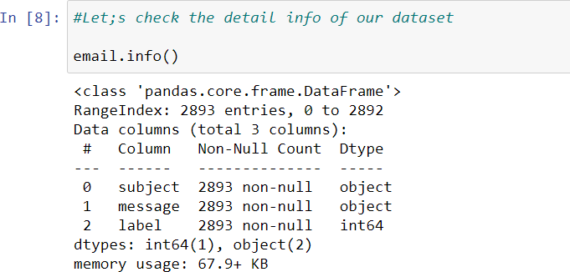
ANALYTICAL PROBLEM FRAMING
MATHEMATICAL/ ANALYTICAL MODELING OF THE PROBLEM
Throughout the project multiple mathematical and analytical models have been used, first we have checked the ratio of spam and ham emails in our dataset. The shape of our data set is 2893 rows and 3 columns.
Then we have used regular expressions to clean the message column which contained body of the email. Then we have used TfidfVectorizer, to transforms text to feature vectors that can be used as input to estimator

Slide 7
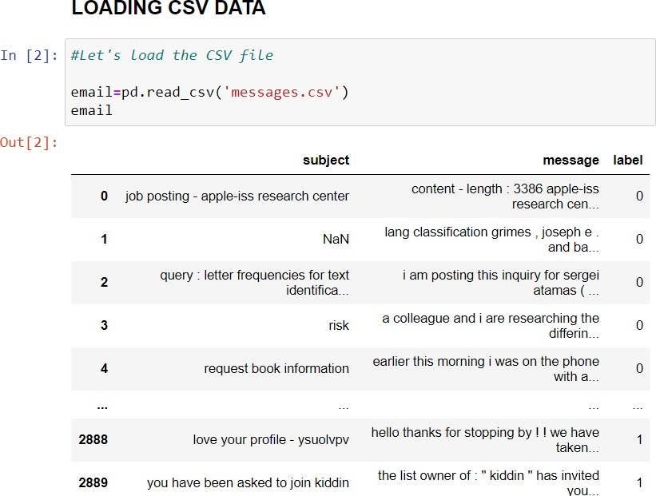
DATA SOURCES AND THEIR FORMATS
The data was provided to us from the FlipRobo Technologies as a part of our internship assignment. The data was provided in CSV format and there were 3 attributes and 2893 rows in the data set.
DATA PREPROCESSING DONE
After loading all the data we will proceeded with the data pre-processing. Following Steps were followed during data pre-processing:

Slide 8
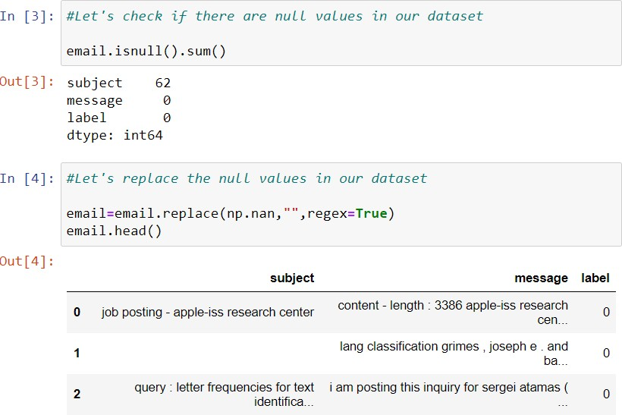
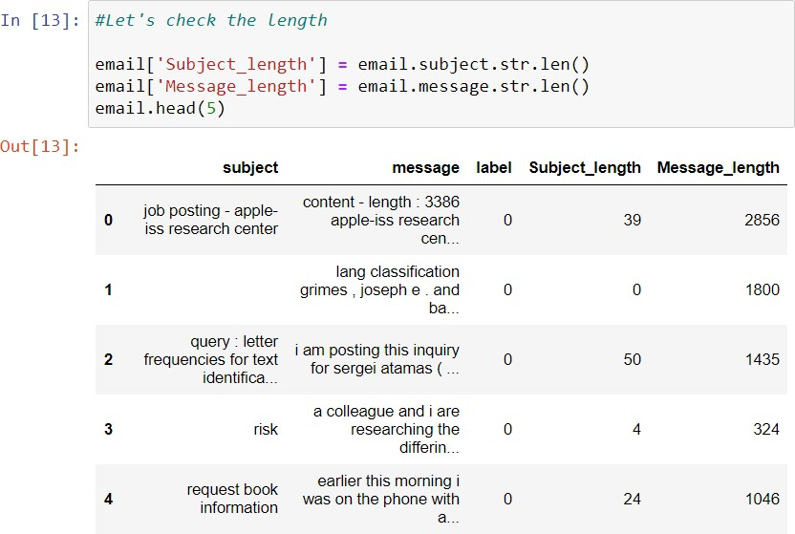
Removing unwanted attribute from Dataset: It’s quite hard to find whether a mail is a spam or not just by looking at the subject. So we started by replacing the null values.
Adding additional attribute :
In order to analyse the data in a better way while doing pre-processing, we have added an attribute ‘Length’ which shows length of the message against it. This was done just to compare the length of text before and after preprocessing and to get idea about the memory optimization.

Slide 9
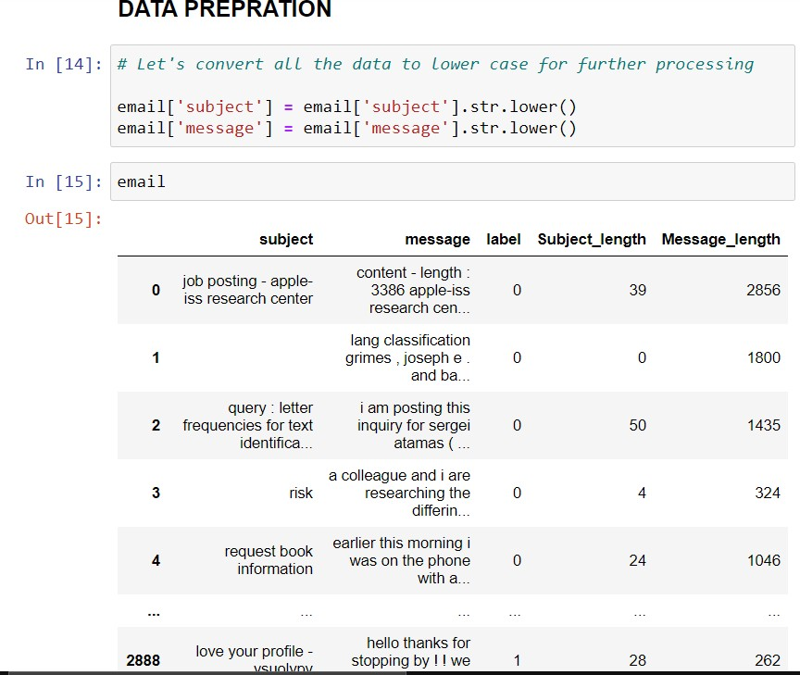
Converting all the messages to lower case:
All messages in the ‘message’ attribute was converted to small case since keeping words in large case does not make sense as same word with small and large case conveys same meaning.

Slide 10
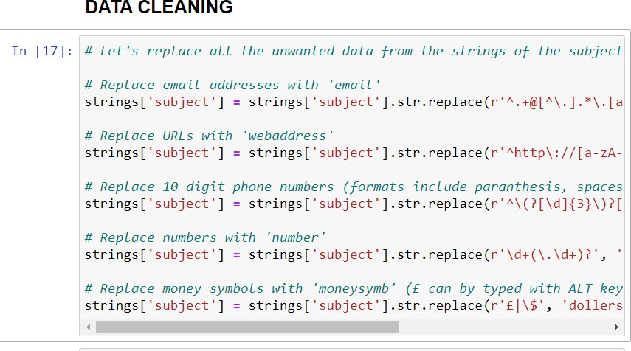
Performing Regex operations:
All messages in the ‘message’ attribute were adjusted to remove unwanted words, characters, numbers etc.
All mail addresses were replaces by single word ‘emailaddress’
All URL’s present in the message were replaced by word ‘webaddress’
All dollars signs ($ , £) were replaced by word ‘dollers’
All 10 digit number sequence were replaced by word ‘phonenumber’
All numbers were replaced with word ‘numbr’
Removing punctuations from the message
Replacing whitespaces between terms with a single space
Removing leading and trailing whitespaces

Slide 11
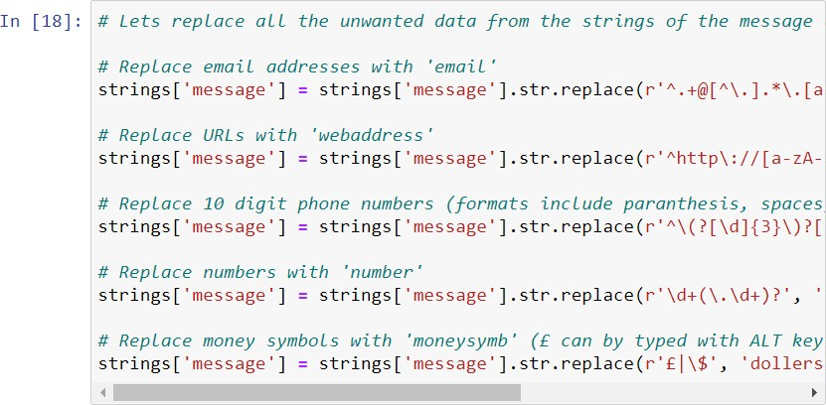
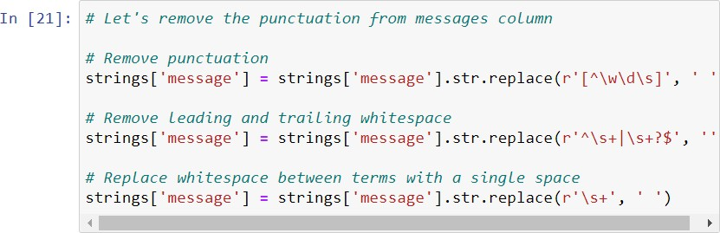
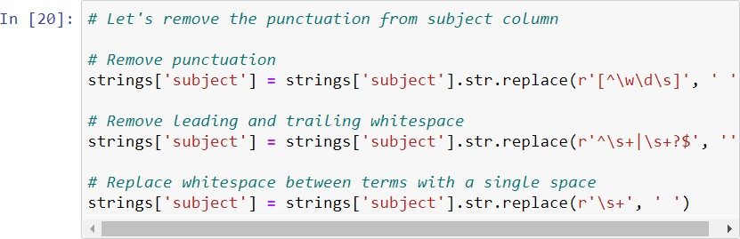
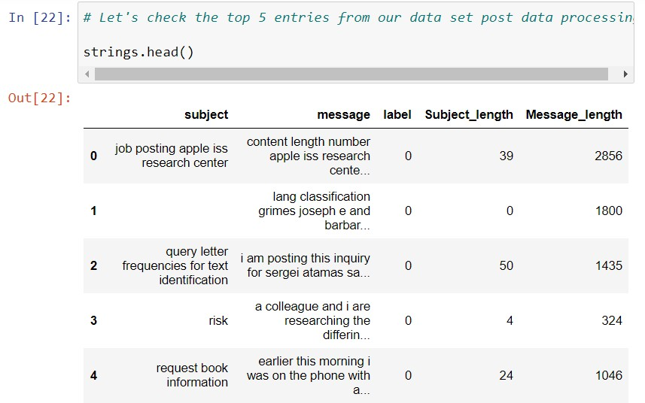

Slide 12
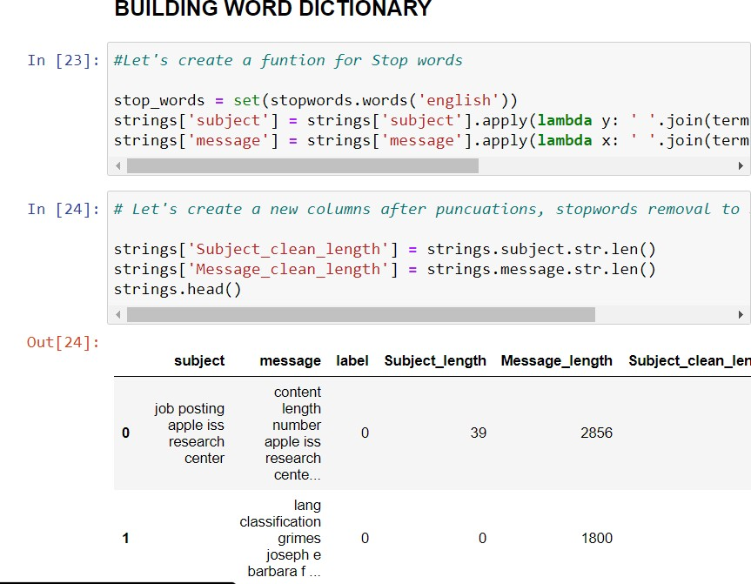
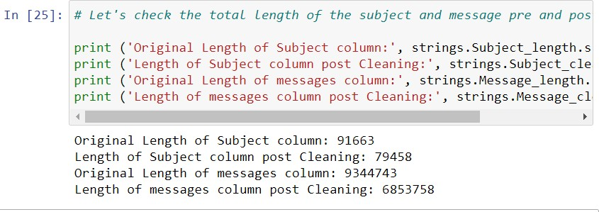
Removal of Stopwords :
All unwanted words which do not contribute much in model building i.e. stopwords, were removed from dataset.
Adding additional attribute:
To compare the length of message before preprocessing and after preprocessing an addition column ‘Cleaned Length’ was added.
After executing all these steps it was found that 2490985 characters were removed from the dataset which were of no use and consuming memory.

Slide 13
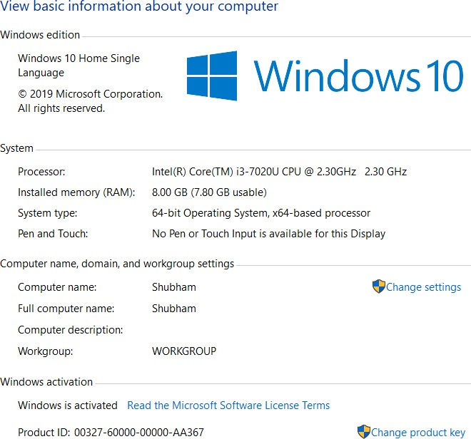
DATA INPUTS- LOGIC- OUTPUT RELATIONSHIPS
We have analysed the words that were present in the spam and ham mails, based on the words present and the data we already have which says if the mail is ham or spam, we are going to train the model to predict the same.
Hardware and Software Requirements and Tools used for Hardware
Softwares
Jupyter Notebook (Anaconda 3) – Python 3.7.6 Microsoft Excel 2010

Slide 14
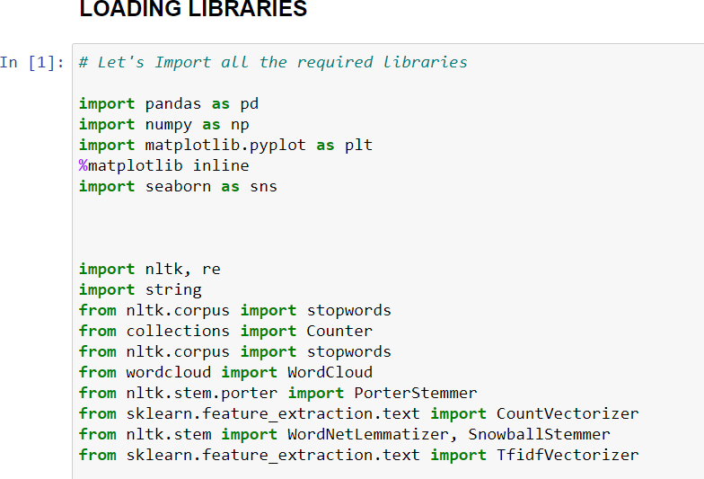
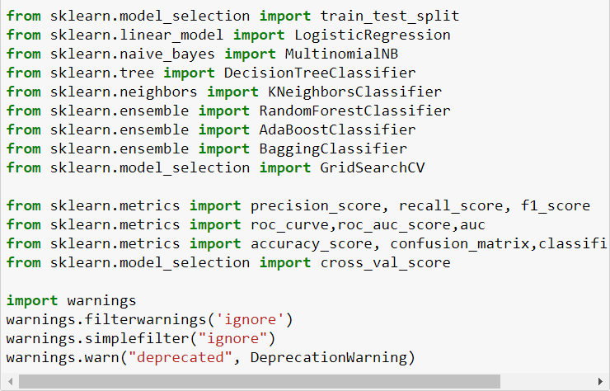
LIBRARIES:

Slide 15
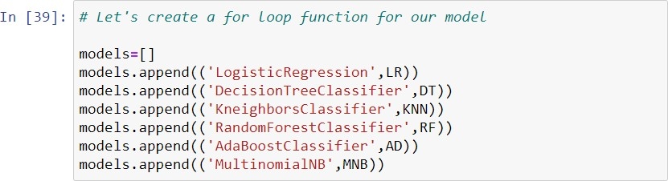
MODEL/S DEVELOPMENT AND EVALUATION
IDENTIFICATION OF POSSIBLE PROBLEM-SOLVING APPROACHES (METHODS)
As the target column was Bivariant data and the algorithm that we choose depends on this target variable. So, we have chosen classification analysis for this project.
TESTING OF IDENTIFIED APPROACHES (ALGORITHMS)
We have used the following algorithms
LogisticRegression()
DecisionTreeClassifier ()
KneighbourClassifier()
RandomForestClassifier ()
AdaBoostClassifier()
MultinomialNB()

Slide 16
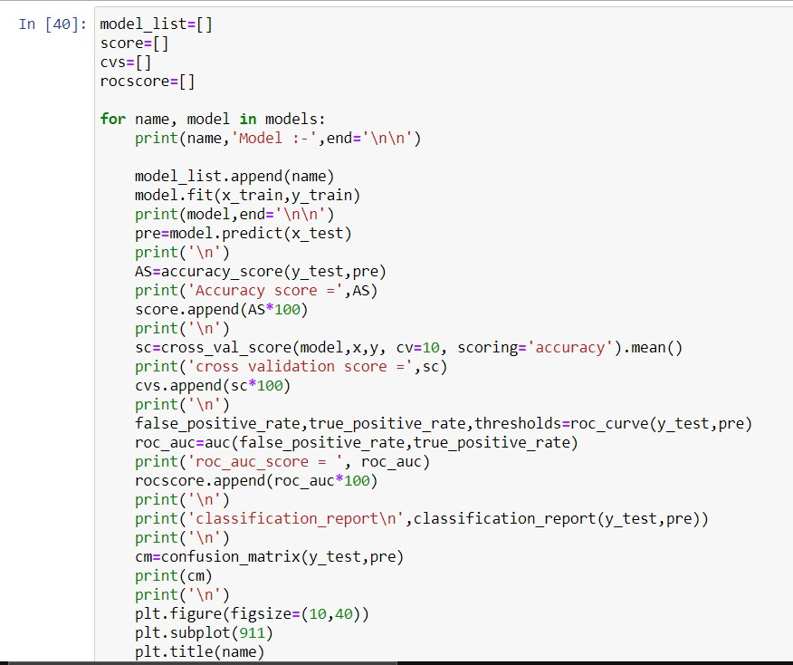
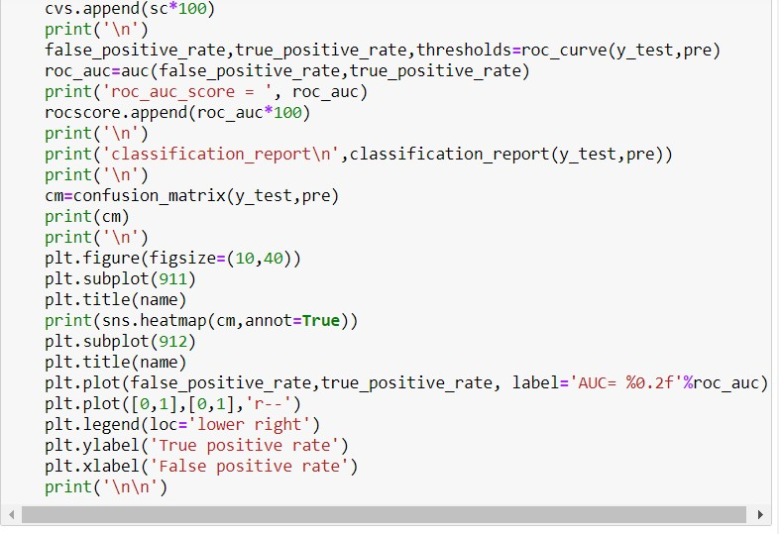

Slide 17
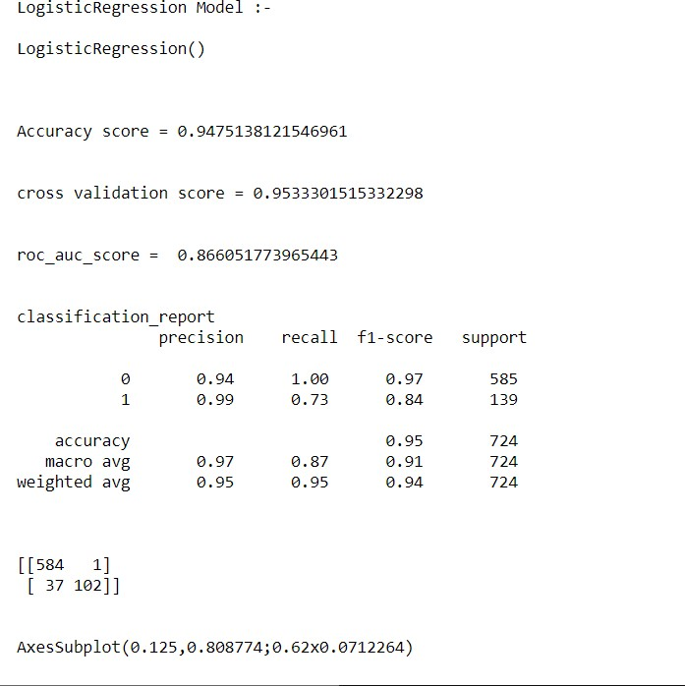
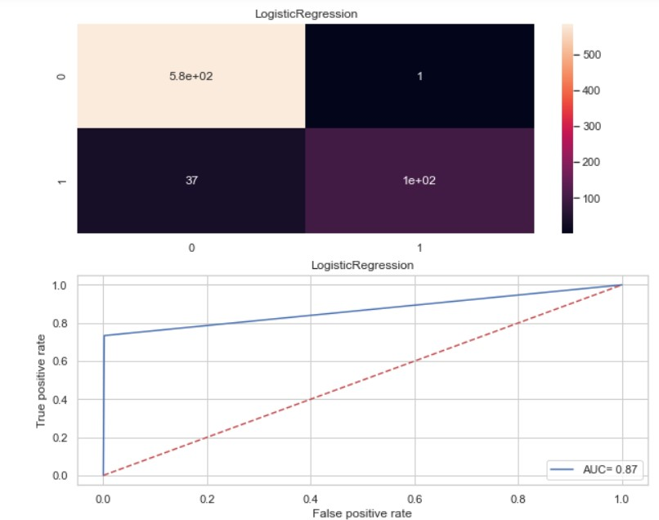

Slide 18
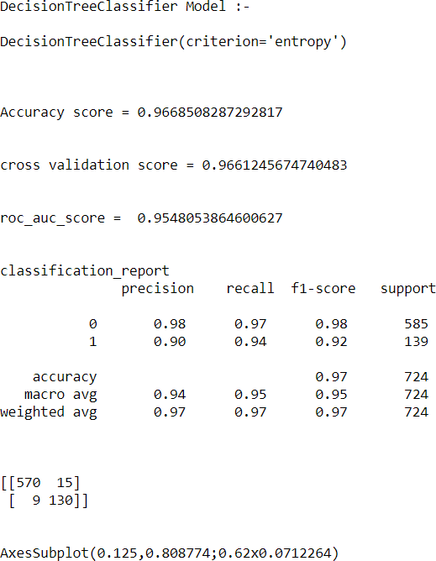
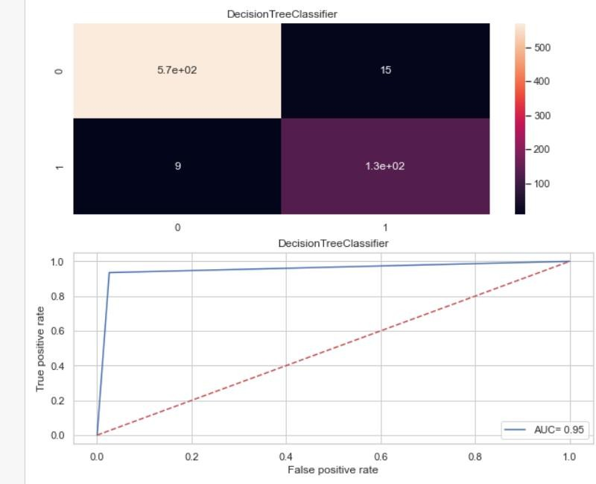

Slide 19
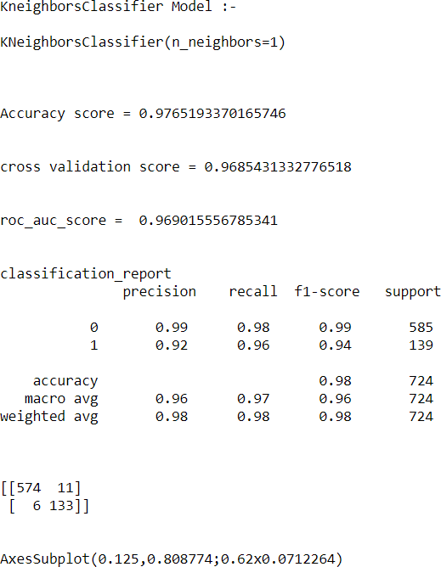
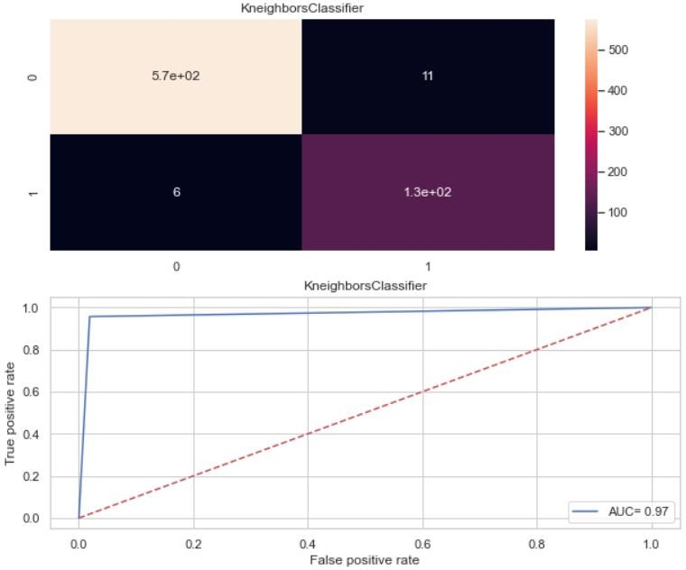

Slide 20
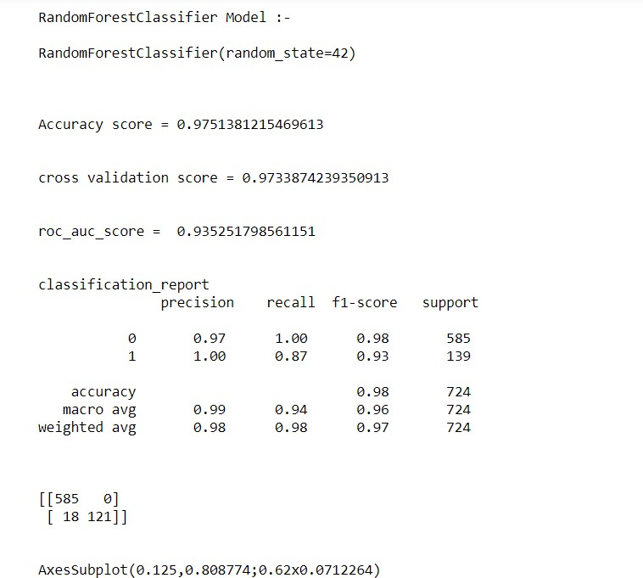
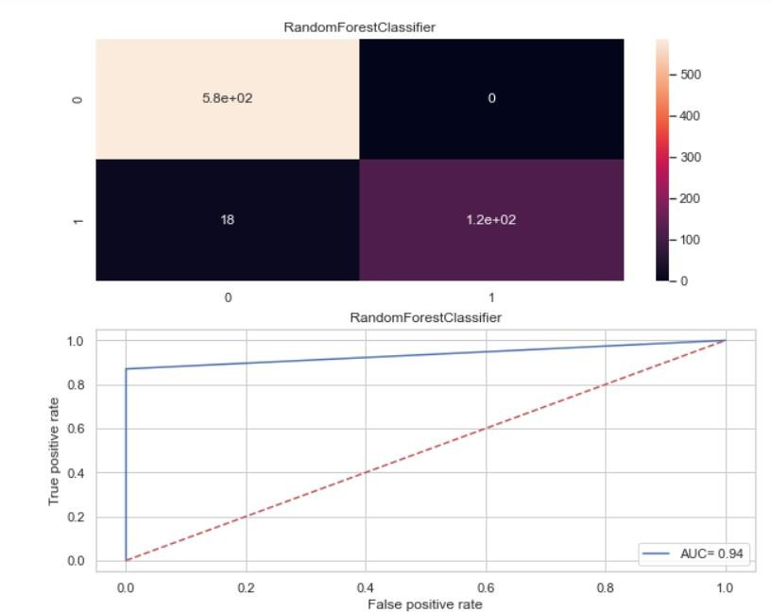

Slide 21
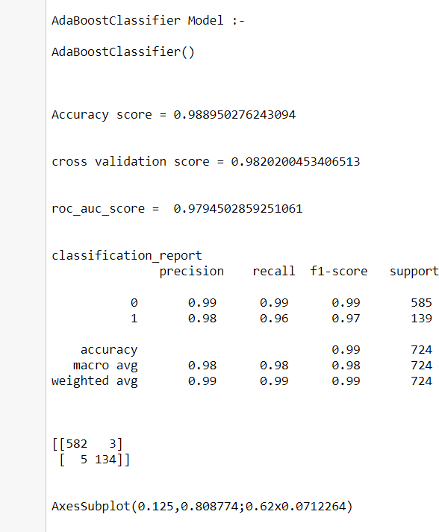


Slide 22
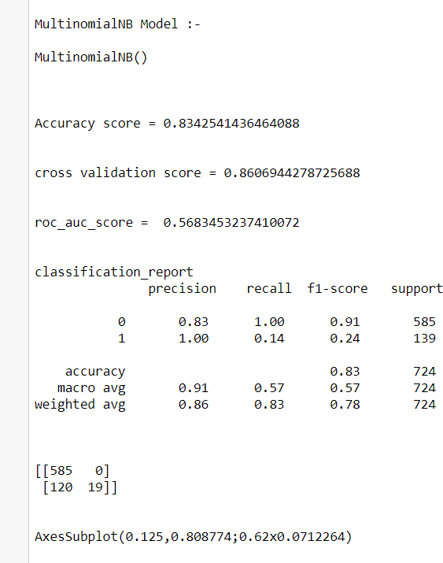
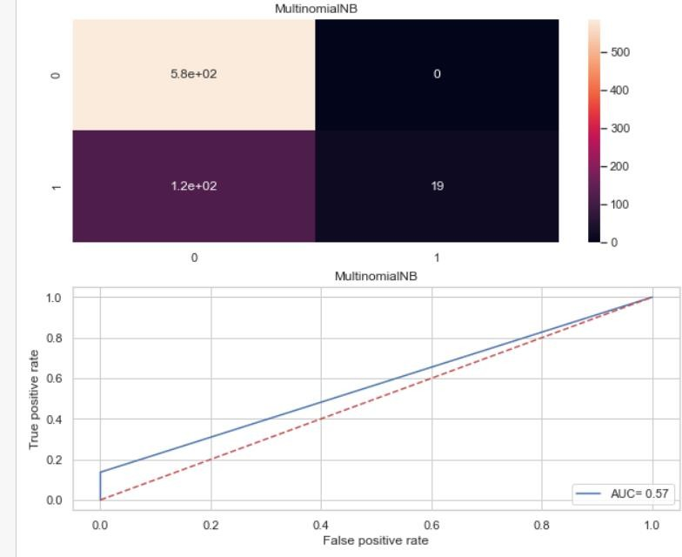

Slide 23
KEY METRICS FOR SUCCESS IN SOLVING PROBLEM UNDER CONSIDERATION
Precision: can be seen as a measure of quality, higher precision means that an algorithm returns more relevant results than irrelevant ones. Recall is used as a measure of quantity and high recall means that an algorithm returns most of the relevant results. Accuracy score is used when the True Positives and True negatives are more important. Accuracy can be used when the class distribution is similar. F1-score is used when the False Negatives and False Positives are crucial. While F1-score is a better metric when there are imbalanced classes.
Cross_val_score: To run cross-validation on multiple metrics and also to return train scores, fit times and score times. Get predictions from each split of cross- validation for diagnostic purposes. Make a scorer from a performance metric or loss function.
roc _auc _score : ROC curve. It is a plot of the false positive rate (x-axis) versus the true positive rate (y-axis) for a number of different candidate threshold values between 0.0 and 1.0

Slide 24
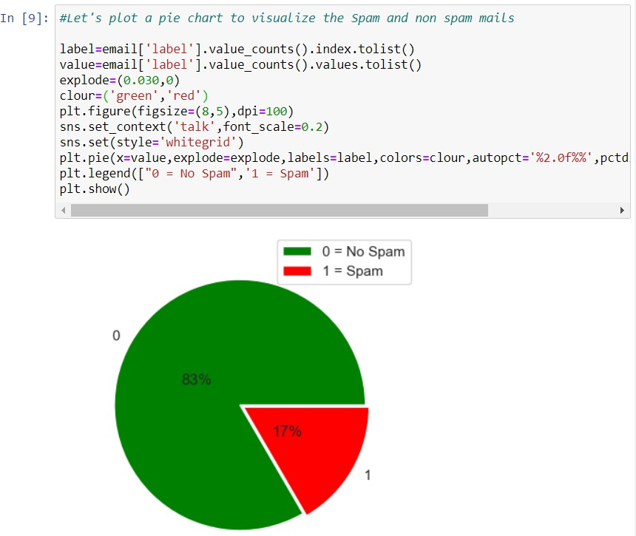
Visualizations

Slide 25
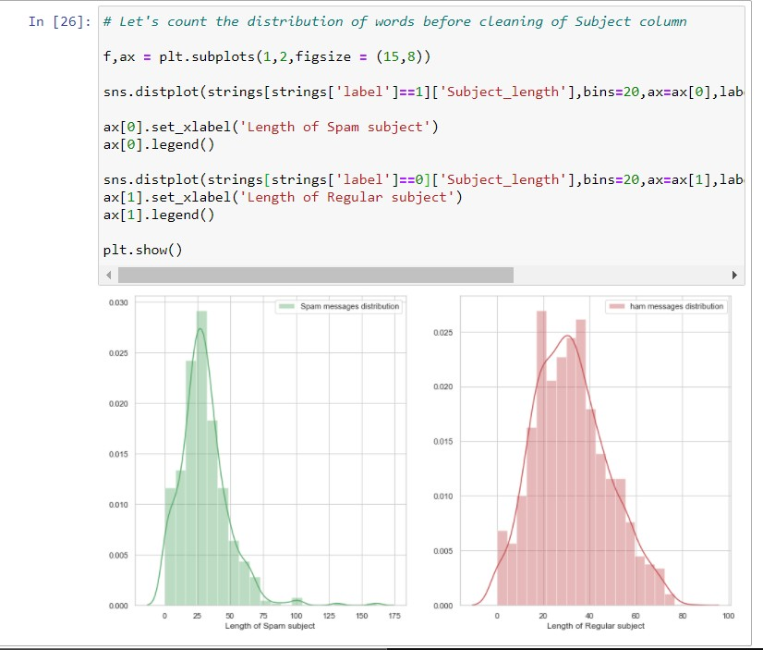
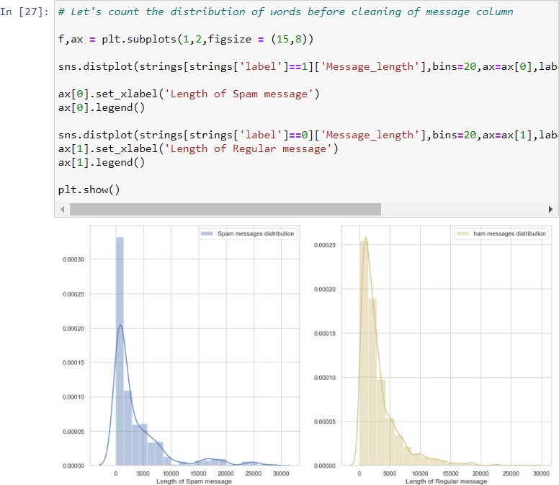

Slide 26
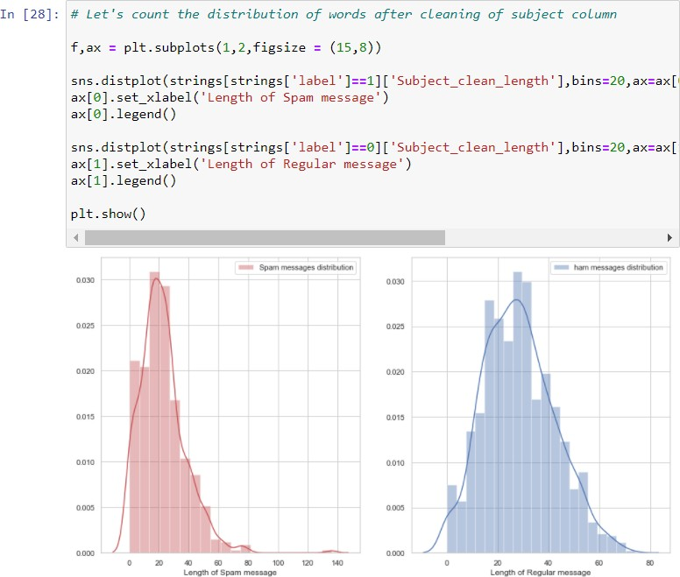
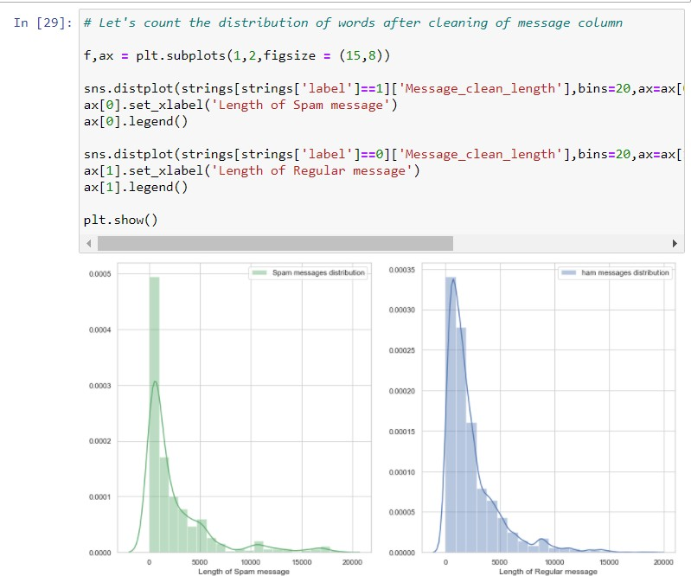

Slide 27
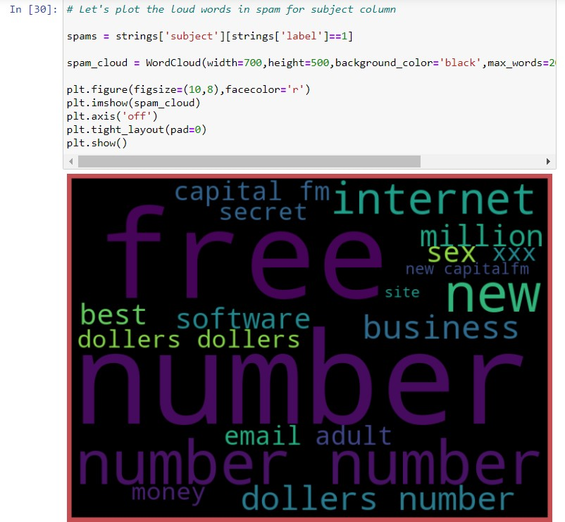
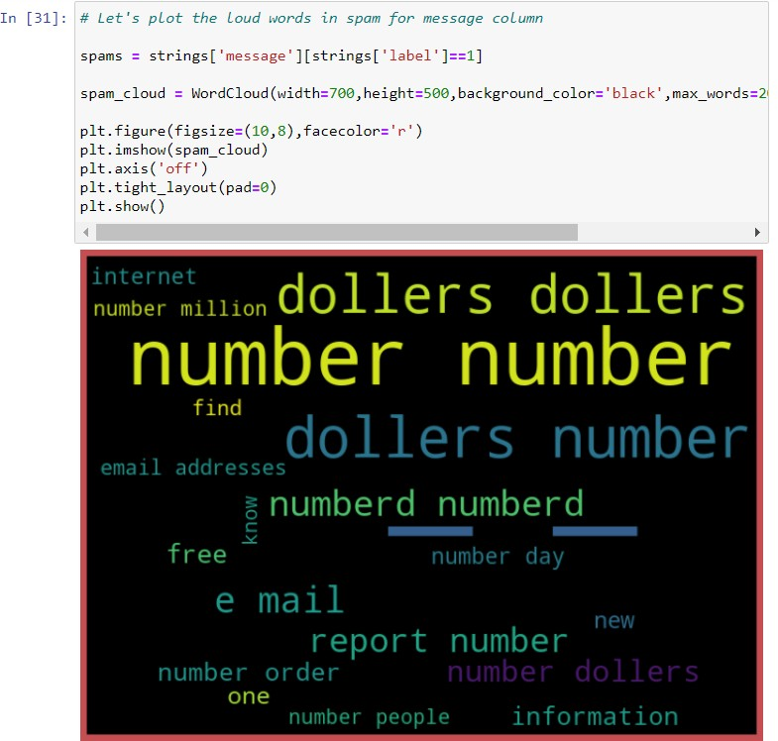

Slide 28
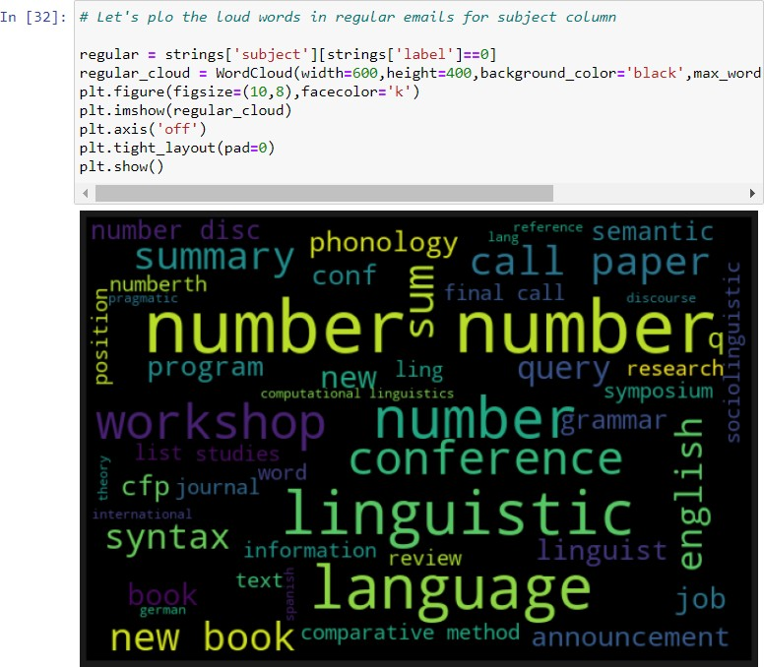
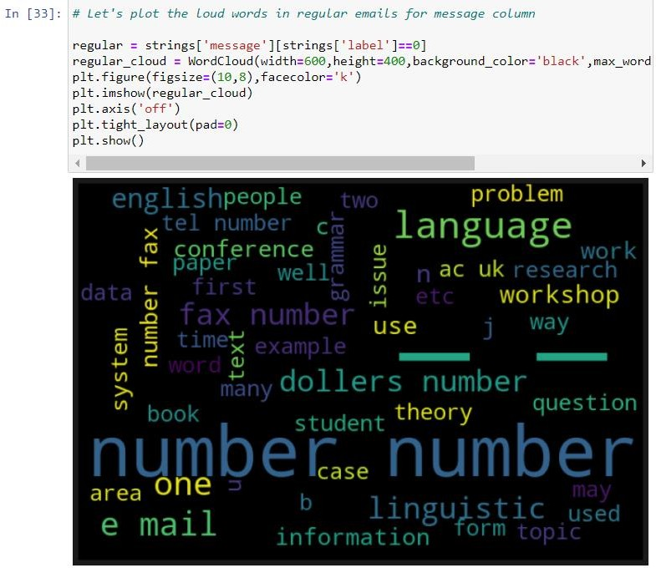

Slide 29
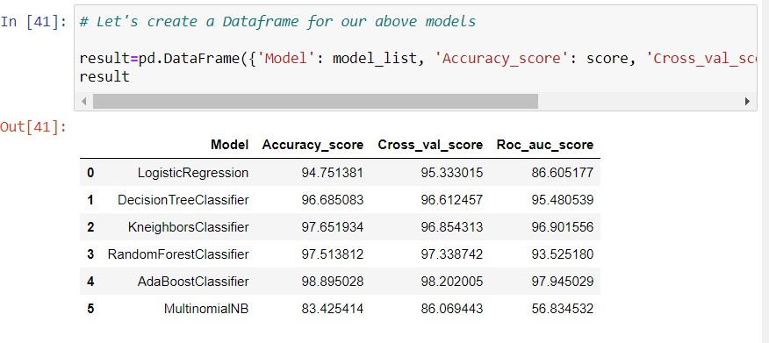
Interpretation of Results

Slide 30
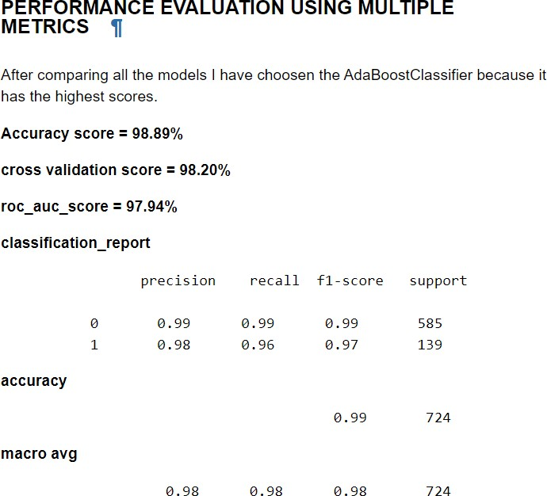
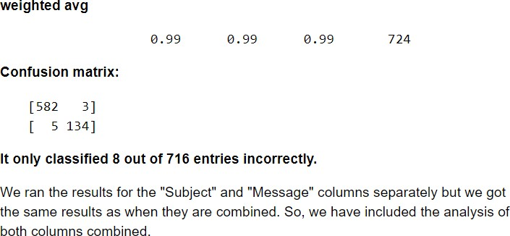

Slide 31

Conclusion
KEY FINDINGS AND CONCLUSIONS OF THE STUDY
From the whole evaluation we found out that the spam emails can be classified and can be stopped doing harm to the users.
LEARNING OUTCOMES OF THE STUDY IN RESPECT OF DATA SCIENCE
I found visualization a very useful technique to infer insights from dataset.
The ROC AUC plot gives large info about the false positive rate and True positive rate at various thresholds.
We are able to classify the emails as spam or non-spam. With high number of emails lots if people using the system, it will be difficult to handle all possible mails as our project deals with only limited amount of corpus

Slide 32

LIMITATIONS OF THIS WORK AND SCOPE FOR FUTURE WORK
Since the data contained a smaller number of ‘1’ target labels. The trained model will be limited in scope for this label. More data of spam can definitely improve the model’s performance on identification of Spam mails.

Slide 33
thank you
Purva Sonsare

